Slide 1
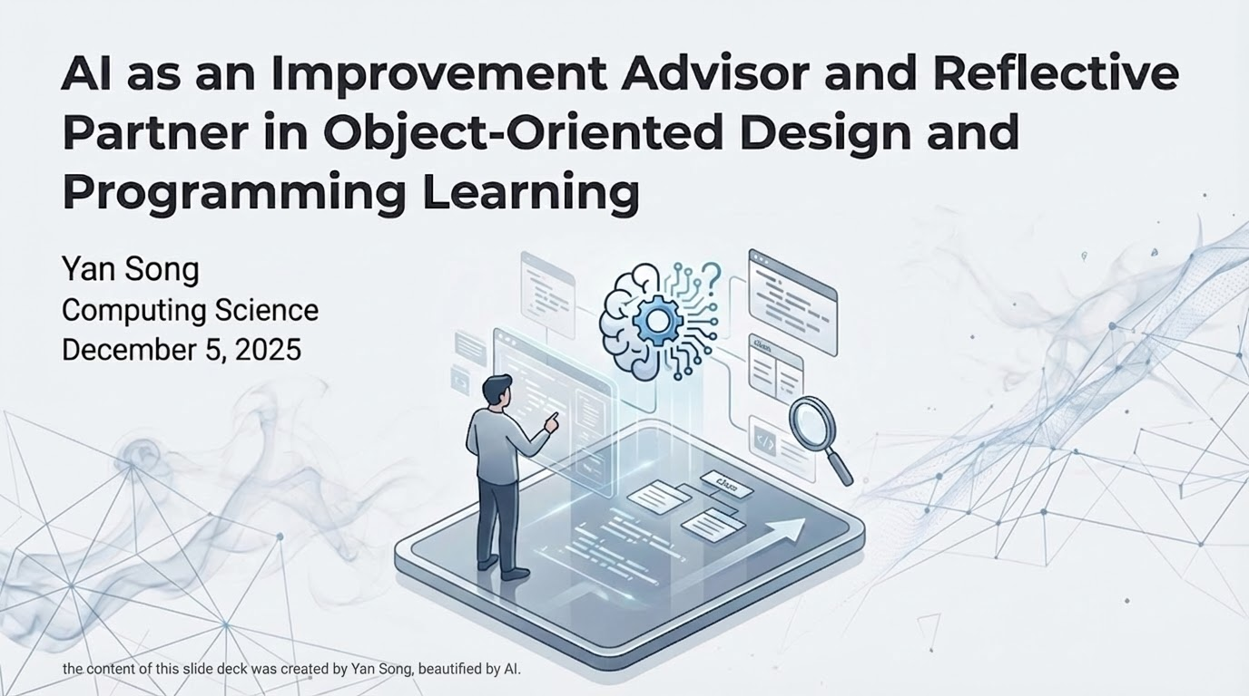
Notes:
OOD is a programming paradigm. It is a modular approach to coding.
It’s simply a way of writing software where you break a big problem down into "things" (Objects) rather than "actions.", treating it like a set of Lego bricks.
This course introduces the fundamentals of OOD and OOP.
To plan the solution.
To build the solution.
Students learn:
the implementation of fundamental programming constructs
the core OOD concepts such as classes, objects, inheritance, polymorphism, and inter-object communication
apply them to build applications

Slide 2
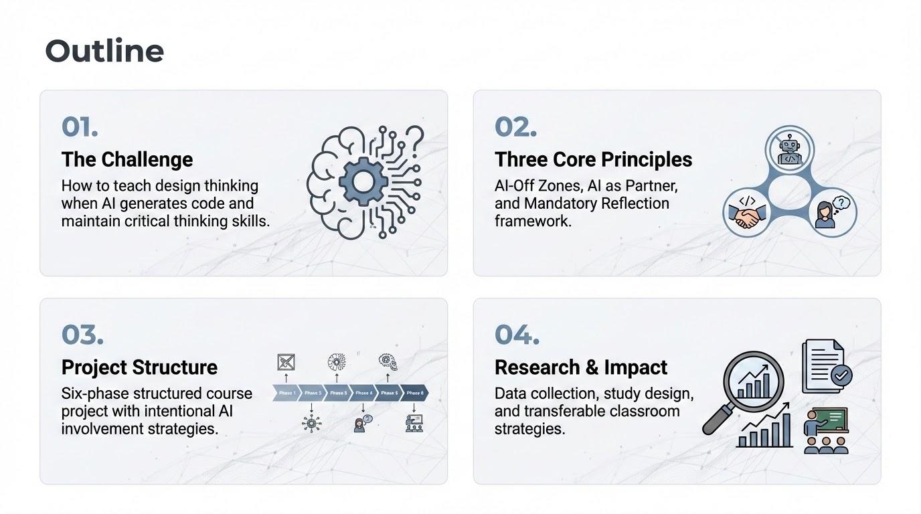

Slide 3
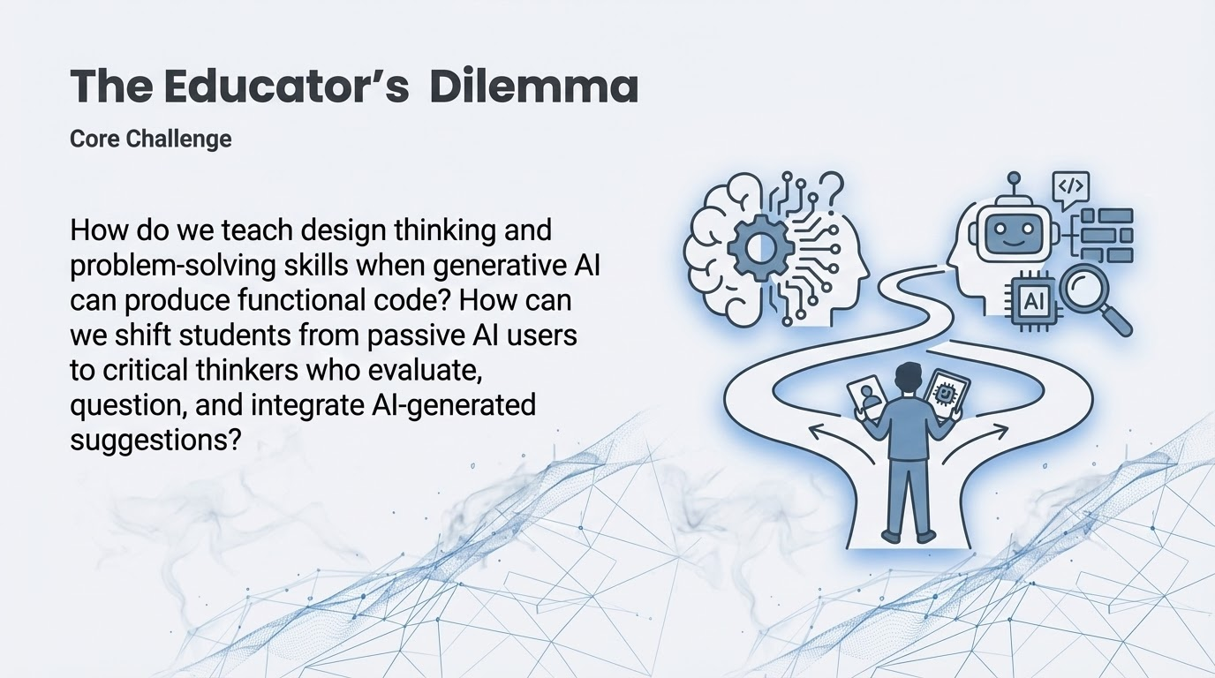
Notes:
Artificial intelligence is rapidly transforming the landscape of computer science education, offering us both profound opportunities and significant challenges.
Because LLMs treat programming syntax like natural language, they can now instantly generate design solutions and functional code for entry-level applications..
However, But this capability creates a critical risk: that students will use these tools to bypass the essential struggle of learning.
The central challenge we face is not stopping the use of AI, but changing how it is used.
Our project aims to shift students from being passive consumers of AI code to critical thinkers who can evaluate, question, and refine the solutions that AI suggests.

Slide 4
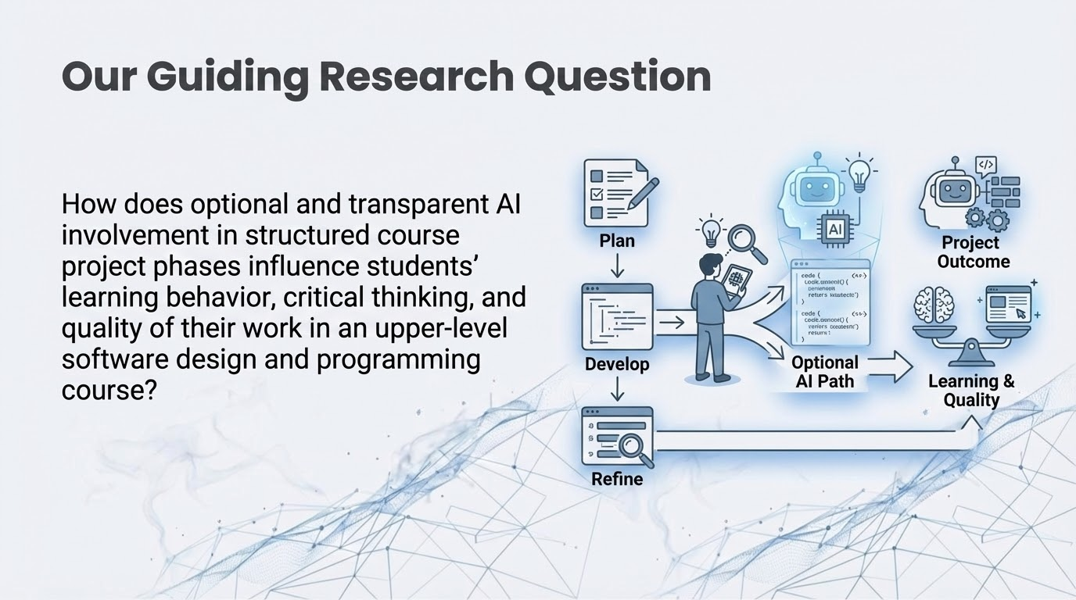
Notes:
The course emphasizes not only technical competence in C++ programming
but also conceptual understanding of abstraction, encapsulation, and modular design as key learning outcomes in software development.

Slide 5
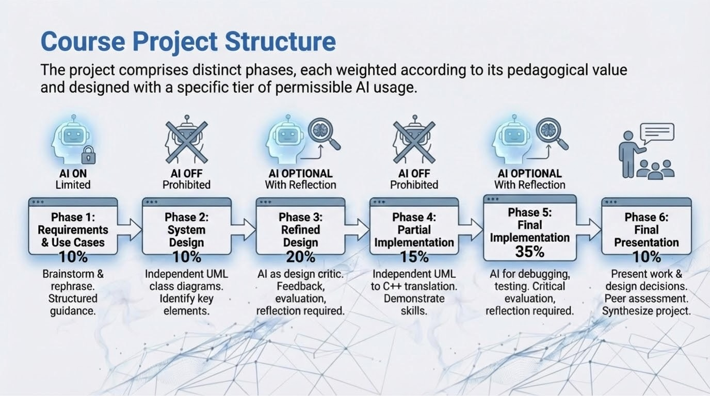
Notes:
The project is intentionally scaffolded to guide students through multiple stages, from design to development, refining on the previous work, building complexity at each stage.
OOD (The Architect): Draws the blueprints. They decide where the walls go, how the rooms connect, and what the building should look like—but they don't touch a single brick.
OOP (The Builder): Takes those blueprints and actually lays the bricks, pours the concrete, and installs the wiring to make the building real.
Permitted Use: Brainstorming ideas, rephrasing requirements for clarity.
Prohibited: Generating entire requirement documents.
Rationale: Students must create the initial class structure on their own to master foundational concepts.
Rationale: Students can use Al as a 'design critic' to refine their work, fostering critical evaluation.
Rationale: Students must translate their design to code skeletons independently, demonstrating core programming skills.
Rationale: Students can use Al for debugging, optimization, or testing feedback, modeling professional workflows.

Slide 6
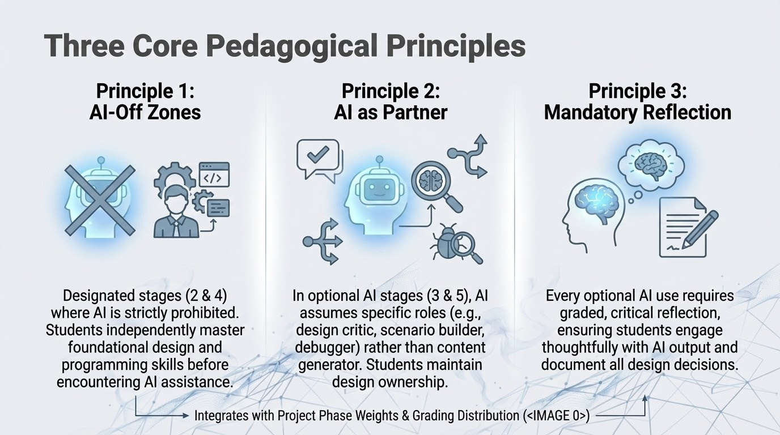
Notes:
Stage 2: Basic Design
Students independently create initial UML class diagrams. Develops foundational OOD skills.
Stage 4: Partial Code
Students translate designs to C++ code skeletons independently. Demonstrates core programming capability.

Slide 7
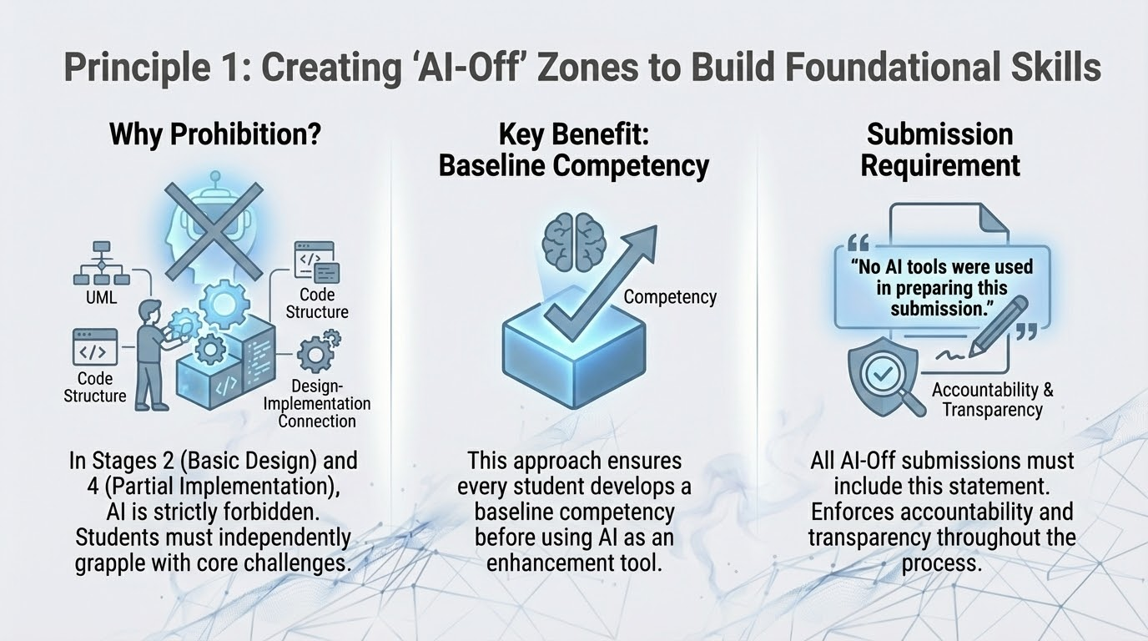

Slide 8
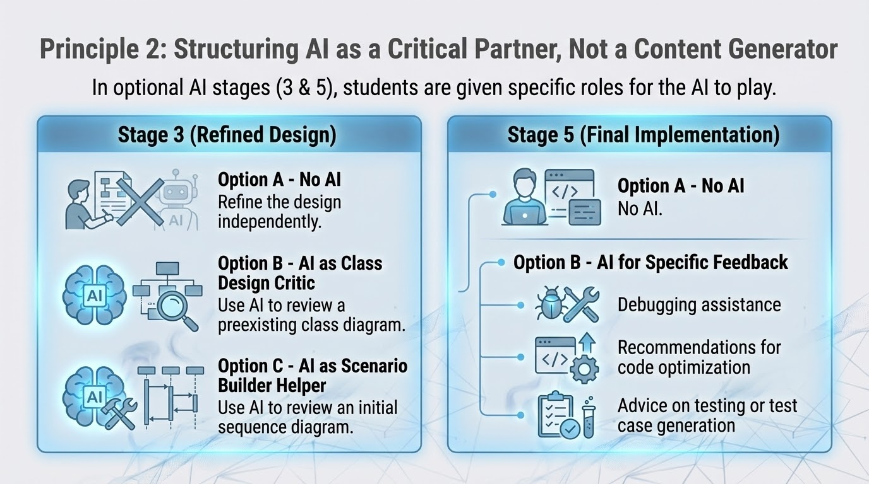
Notes:
Stage 3:
Option B: Student provides their completed class diagrams. AI reviews and points out unclear or missing interactions, ambiguous abstractions, or design inconsistencies without generating new designs.
Option C: Use AI to review ONE of your initial sequences of object interactions.

Slide 9
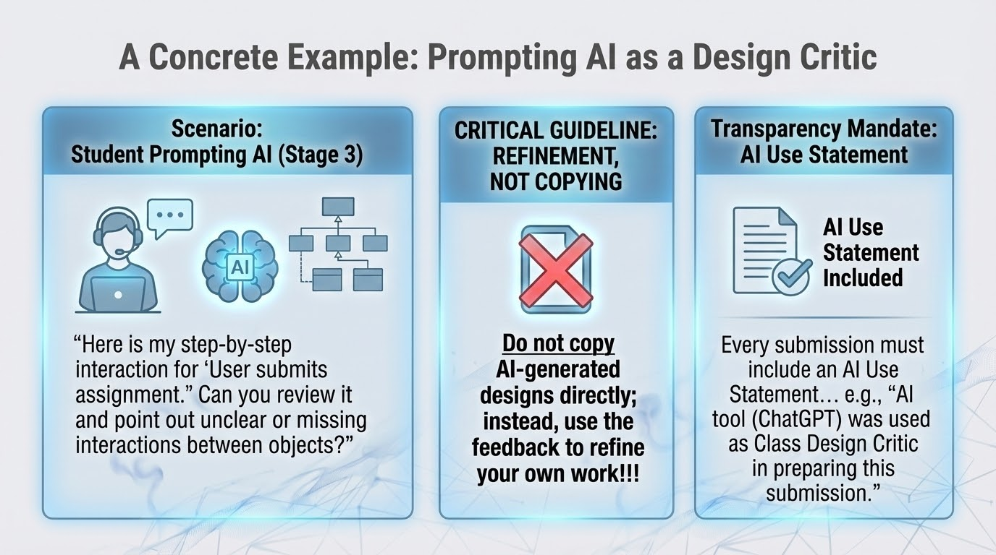
Notes:
A student in Stage 3 wants feedback on their class diagram.
The instruction of stage 3 gives an Example of Prompt Example
And also explicitly states that Do not copy…

Slide 10
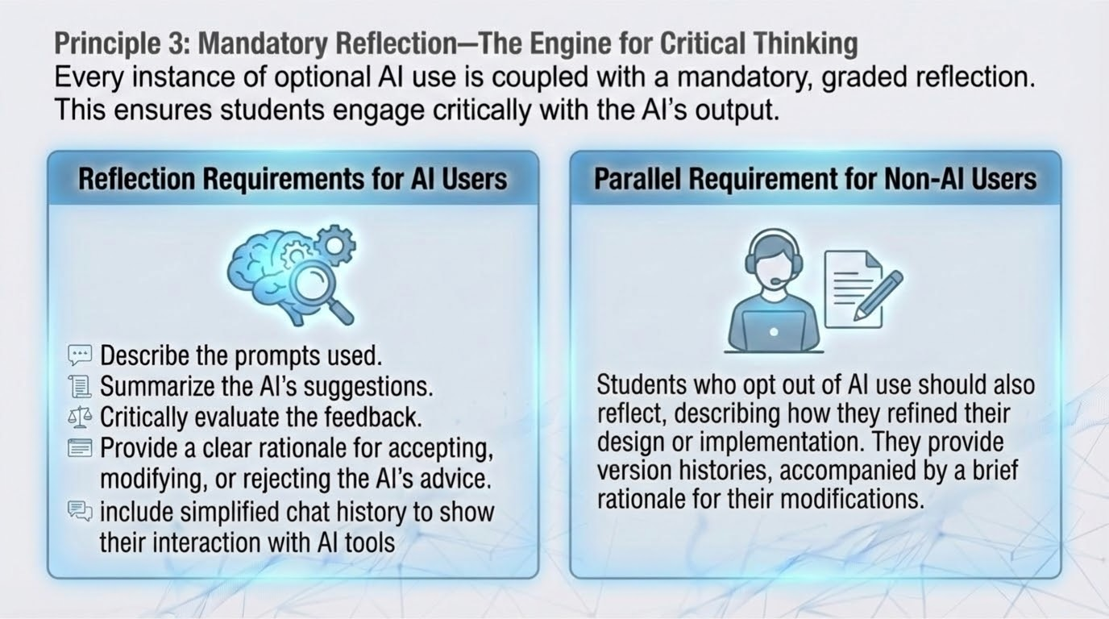
Notes:
For AI options:
Student critically evaluates all AI feedback:
Which suggestions improve clarity? Which are irrelevant?
Why accept or reject each piece of feedback?
Document rationale alongside design revisions.
For non-AI users: ensure equitable effort and assessment

Slide 11
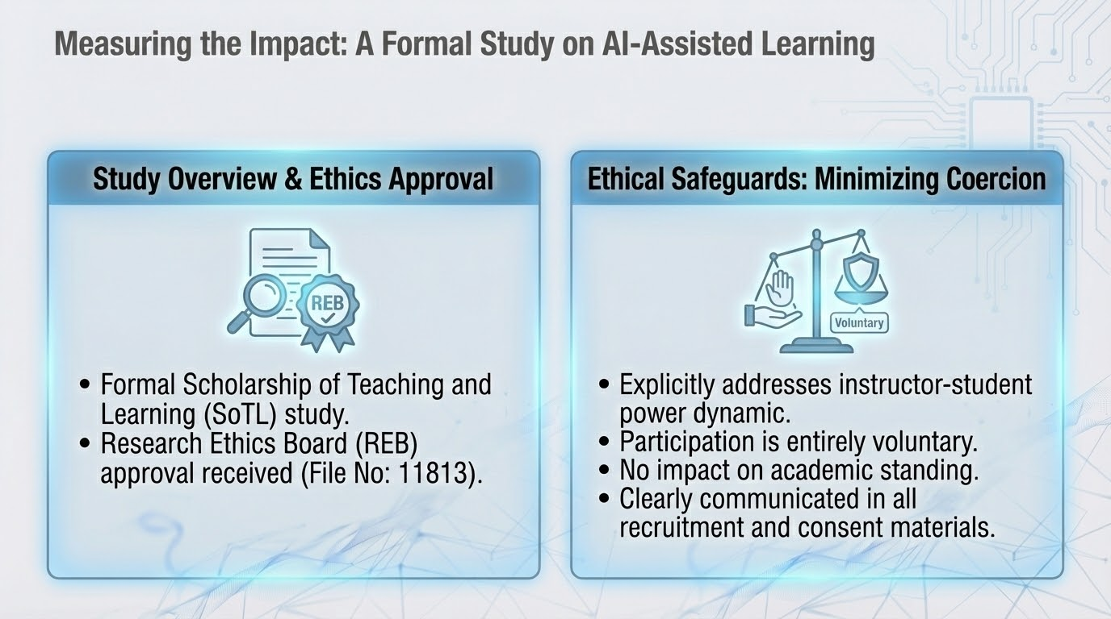

Slide 12
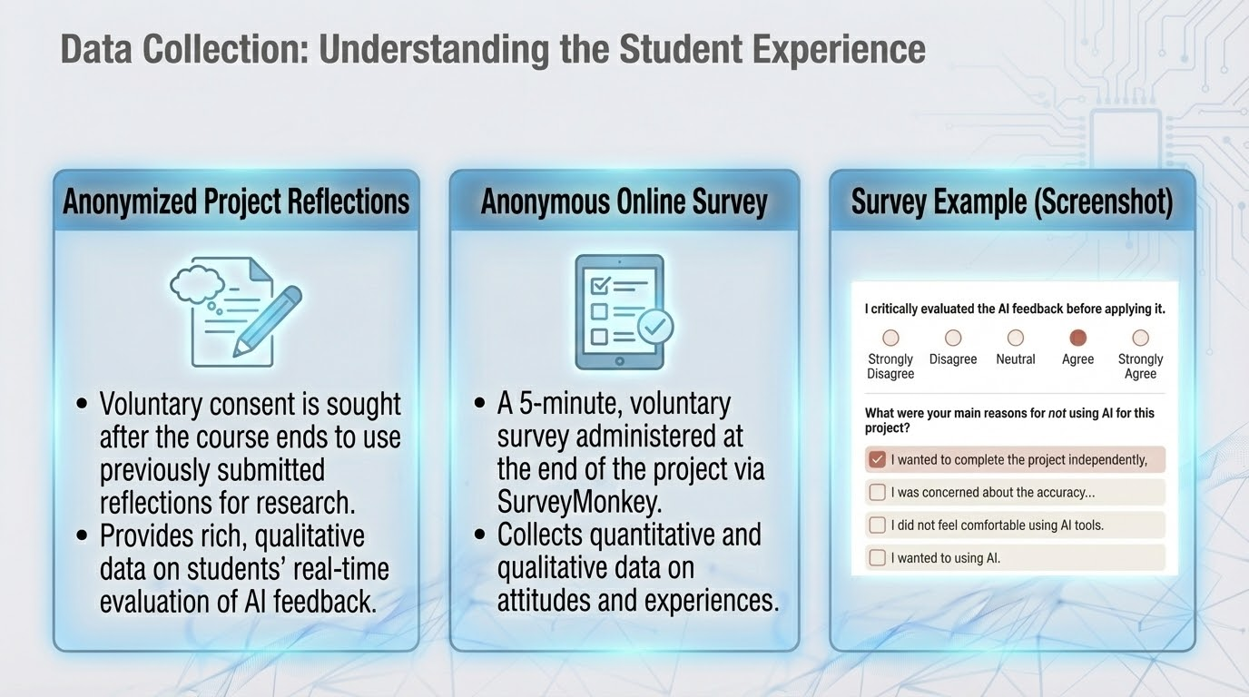

Slide 13
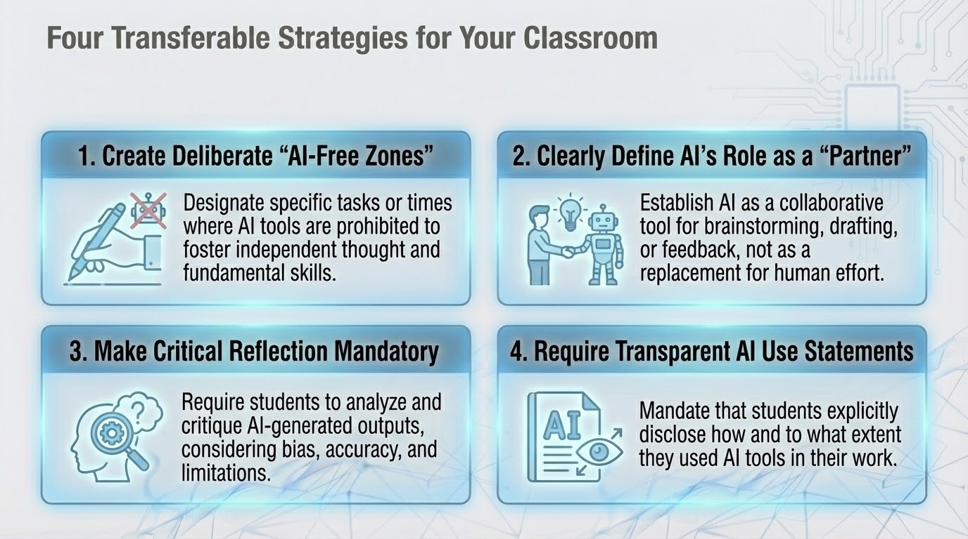
Notes:
Following the the GenAI Assessment Scale, we can adjust or adapt the different levels of AI use to fit our course assignment or assessment.
We identify the foundational skills that students must master independently and prohibit Al use for these specific tasks.
We can define different AI’s roles such as a critic, an improvement provider, but not as the content creator.
Provide example prompt which guide them to play with AI meaningfully and appropriately. Provide them with clear intent and expectation of how to use AI responsibility and effectively.
Mandatory reflection is essential. We can tie any use of Al to a graded reflection where students must justify their interaction and decisions.
This is important for turning Al use into a learning activity. Some students may do so without requirement but I believe lots of them will not.
I believe making it mandatory gives them the opportunity to critically evaluate AI’s output, consider bias and AI’s limitations.
Mandate a simple declaration of Al use. Also give them some examples or templates.
This helps normalize transparency and fosters academic integrity.

